Slide 1
In Pictures:
ONE WORLD, MANY PARTIES
from
<http://cnn.com/SPECIALS/1999/at2000>

Slide 2
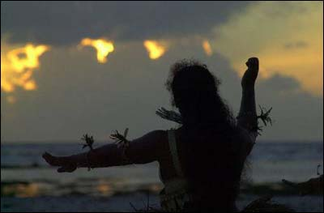
Milennium Island, Kiribati

Slide 3
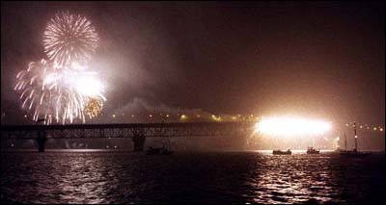
Auckland, New Zealand

Slide 4
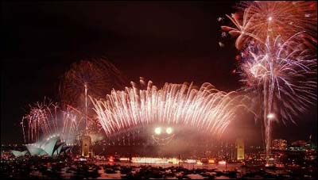
Sydney, Australia

Slide 5
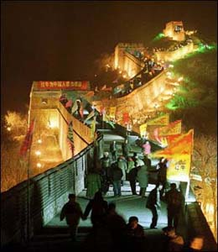
The Great Wall, China

Slide 6
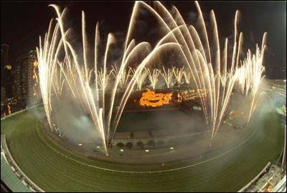
Hong Kong

Slide 7
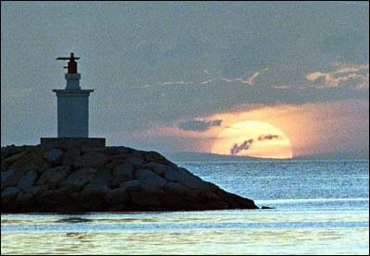
Sunset in Manila, Philippines

Slide 8
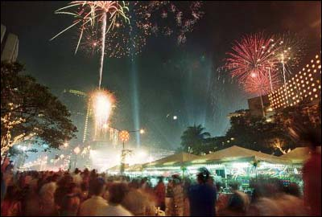
Manila, Philippines

Slide 9
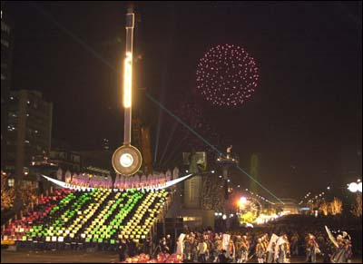
Seoul, South Korea

Slide 10
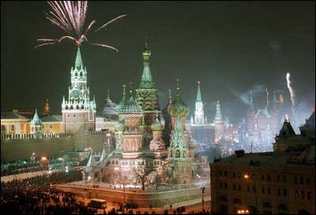
Red Square in Moscow, Russia

Slide 11
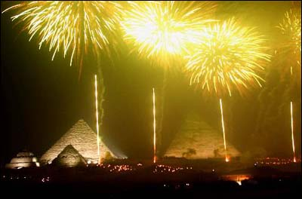
The Giza Pyramids, Egypt

Slide 12
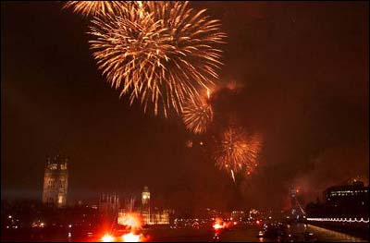
The River Thames in London, England

Slide 13
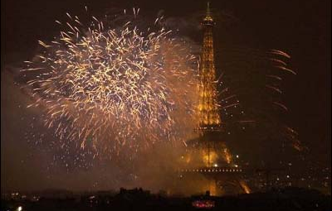
The Eiffel Tower in Paris, France

Slide 14
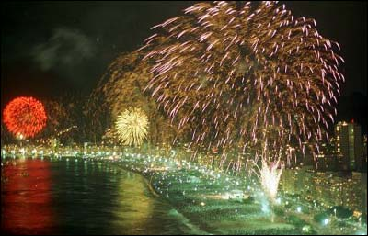
Copacabana Beach in Rio de Janeiro, Brazil

Slide 15
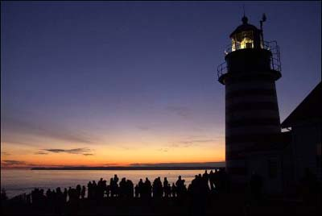
Maine, USA

Slide 16
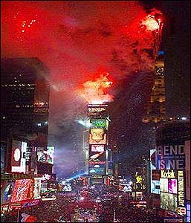
Times Square in New York City, USA

Slide 17
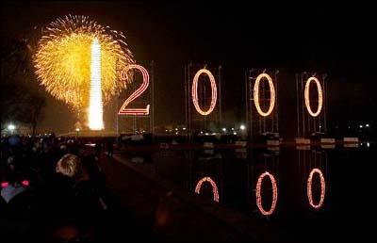
The Mall in Washington DC, USA

Slide 18
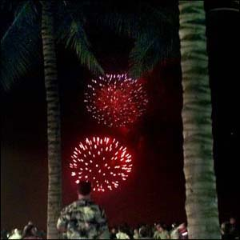
Honolulu, Hawaii, USA

Slide 19
Have a blessed year ahead !
Happy New Millennium !!!

